Slide 1
April 19 Discussion
CDA 3101

Slide 2
Examlet 6
Virtual memory
Map virtual memory address to page map table
Translate virtual address to physical address
TLB
Cache coherence
Parallel Processing – Amdahls Law
Flynn’s Taxonomy
Multithreading
GPUs

Slide 3
Page Map Table
Page | Frame | Valid
0000 | 110 | 1
0001 |  | 0
0010 | 011 | 1
0011 |  | 0
0100 | 010 | 1
0101 |  | 0
0110 | 100 | 1
0111 |  | 0
1000 | 111 | 1
1001 |  | 0
1010 |  | 0
1011 | 000 | 1
1100 |  | 0
1101 |  | 0
1110 | 001 | 1
1111 | 101 | 1
Pages in virtual memory are mapped to frames in physical memory (main memory)

Slide 4
Page Map Table
A system has 2¹⁷ bytes of virtual address space. A frame is 2¹³ bytes. Physical address space (main memory) is 2¹⁶ bytes
How many bits are in the virtual address?
How many bits are in the physical address?
Page | Frame | Valid
0000 | 110 | 1
0001 |  | 0
0010 | 011 | 1
0011 |  | 0
0100 | 010 | 1
0101 |  | 0
0110 | 100 | 1
0111 |  | 0
1000 | 111 | 1
1001 |  | 0
1010 |  | 0
1011 | 000 | 1
1100 |  | 0
1101 |  | 0
1110 | 001 | 1
1111 | 101 | 1

Slide 5
Page Map Table
A system has 2¹⁷ bytes of virtual address space. A frame is 2¹³ bytes. Physical address space (main memory) is 2¹⁶ bytes
How many bits are in the virtual address? log(2¹⁷) = 17
How many bits are in the physical address? log(2¹⁶) = 16
Page | Frame | Valid
0000 | 110 | 1
0001 |  | 0
0010 | 011 | 1
0011 |  | 0
0100 | 010 | 1
0101 |  | 0
0110 | 100 | 1
0111 |  | 0
1000 | 111 | 1
1001 |  | 0
1010 |  | 0
1011 | 000 | 1
1100 |  | 0
1101 |  | 0
1110 | 001 | 1
1111 | 101 | 1

Slide 6
Page Map Table
A system has 2¹⁷ bytes of virtual address space. A frame is 2¹³ bytes. Physical address space (main memory) is 2¹⁶ bytes
How many bits are in the virtual address? log(2¹⁷) = 17
How many bits are in the physical address? log(2¹⁶) = 16
How many bits are in the offset field?
How many bits are in the page field of the virtual address?
How many bits are in the frame field of the physical address?
Page | Frame | Valid
0000 | 110 | 1
0001 |  | 0
0010 | 011 | 1
0011 |  | 0
0100 | 010 | 1
0101 |  | 0
0110 | 100 | 1
0111 |  | 0
1000 | 111 | 1
1001 |  | 0
1010 |  | 0
1011 | 000 | 1
1100 |  | 0
1101 |  | 0
1110 | 001 | 1
1111 | 101 | 1

Slide 7
Page Map Table
A system has 2¹⁷ bytes of virtual address space. A frame is 2¹³ bytes. Physical address space (main memory) is 2¹⁶ bytes
How many bits are in the virtual address? log(2¹⁷) = 17
How many bits are in the physical address? log(2¹⁶) = 16
How many bits are in the offset field?
How many bits are in the page field of the virtual address?
How many bits are in the frame field of the physical address?
Page | Frame | Valid
0000 | 110 | 1
0001 |  | 0
0010 | 011 | 1
0011 |  | 0
0100 | 010 | 1
0101 |  | 0
0110 | 100 | 1
0111 |  | 0
1000 | 111 | 1
1001 |  | 0
1010 |  | 0
1011 | 000 | 1
1100 |  | 0
1101 |  | 0
1110 | 001 | 1
1111 | 101 | 1

Slide 8
Page Map Table
A system has 2¹⁷ bytes of virtual address space. A frame is 2¹³ bytes. Physical address space (main memory) is 2¹⁶ bytes
How many bits are in the virtual address? log(2¹⁷) = 17
How many bits are in the physical address? log(2¹⁶) = 16
How many bits are in the offset field? 13
How many bits are in the page field of the virtual address? 17-13=4
How many bits are in the frame field of the physical address? 16-13=3
Page | Frame | Valid
0000 | 110 | 1
0001 |  | 0
0010 | 011 | 1
0011 |  | 0
0100 | 010 | 1
0101 |  | 0
0110 | 100 | 1
0111 |  | 0
1000 | 111 | 1
1001 |  | 0
1010 |  | 0
1011 | 000 | 1
1100 |  | 0
1101 |  | 0
1110 | 001 | 1
1111 | 101 | 1

Slide 9
Page Map Table
A system has 2¹⁷ bytes of virtual address space. A frame is 2¹³ bytes. Physical address space (main memory) is 2¹⁶ bytes
How many bits are in the virtual address? log(2¹⁷) = 17
How many bits are in the physical address? log(2¹⁶) = 16
How many bits are in the offset field? 13
How many bits are in the page field of the virtual address? 17-13=4
How many bits are in the frame field of the physical address? 16-13=3
The virtual address 0x1F323 is requested. Is this is a hit in the page map table? What does this mean?
Page | Frame | Valid
0000 | 110 | 1
0001 |  | 0
0010 | 011 | 1
0011 |  | 0
0100 | 010 | 1
0101 |  | 0
0110 | 100 | 1
0111 |  | 0
1000 | 111 | 1
1001 |  | 0
1010 |  | 0
1011 | 000 | 1
1100 |  | 0
1101 |  | 0
1110 | 001 | 1
1111 | 101 | 1

Slide 10
Page Map Table
A system has 2¹⁷ bytes of virtual address space. A frame is 2¹³ bytes. Physical address space (main memory) is 2¹⁶ bytes
How many bits are in the virtual address? log(2¹⁷) = 17
How many bits are in the physical address? log(2¹⁶) = 16
How many bits are in the offset field? 13
How many bits are in the page field of the virtual address? 17-13=4
How many bits are in the frame field of the physical address? 16-13=3
The virtual address 0x1F323 is requested. Is this is a hit in the page map table? What does this mean?
0001 1111 0011 0010 0011
Take right 17 bits for address
11111001100100011
1111 1001100100011
Page =1111
This is a hit: this means that page maps to a frame in main memory
Page | Frame | Valid
0000 | 110 | 1
0001 |  | 0
0010 | 011 | 1
0011 |  | 0
0100 | 010 | 1
0101 |  | 0
0110 | 100 | 1
0111 |  | 0
1000 | 111 | 1
1001 |  | 0
1010 |  | 0
1011 | 000 | 1
1100 |  | 0
1101 |  | 0
1110 | 001 | 1
1111 | 101 | 1

Slide 11
Page Map Table
A system has 2¹⁷ bytes of virtual address space. A frame is 2¹³ bytes. Physical address space (main memory) is 2¹⁶ bytes
How many bits are in the virtual address? log(2¹⁷) = 17
How many bits are in the physical address? log(2¹⁶) = 16
How many bits are in the offset field? 13
How many bits are in the page field of the virtual address? 17-13=4
How many bits are in the frame field of the physical address? 16-13=3
The virtual address 0x1F323 is requested. Is this is a hit in the page map table? What does this mean?
1111 1001100100011
Page =1111
This is a hit: this means that page maps to a frame in main memory
Translate the virtual address to a physical address
Page | Frame | Valid
0000 | 110 | 1
0001 |  | 0
0010 | 011 | 1
0011 |  | 0
0100 | 010 | 1
0101 |  | 0
0110 | 100 | 1
0111 |  | 0
1000 | 111 | 1
1001 |  | 0
1010 |  | 0
1011 | 000 | 1
1100 |  | 0
1101 |  | 0
1110 | 001 | 1
1111 | 101 | 1

Slide 12
Page Map Table
A system has 2¹⁷ bytes of virtual address space. A frame is 2¹³ bytes. Physical address space (main memory) is 2¹⁶ bytes
How many bits are in the virtual address? log(2¹⁷) = 17
How many bits are in the physical address? log(2¹⁶) = 16
How many bits are in the offset field? 13
How many bits are in the page field of the virtual address? 17-13=4
How many bits are in the frame field of the physical address? 16-13=3
The virtual address 0x1F323 is requested. Is this is a hit in the page map table? What does this mean?
1111 1001100100011
Page =1111
This is a hit: this means that page maps to a frame in main memory
Translate the virtual address to a physical address
Frame = 101, replace page with frame
Physical address = 101 1001100100011
= 1011 0011 0010 0011 = 0xB323
Page | Frame | Valid
0000 | 110 | 1
0001 |  | 0
0010 | 011 | 1
0011 |  | 0
0100 | 010 | 1
0101 |  | 0
0110 | 100 | 1
0111 |  | 0
1000 | 111 | 1
1001 |  | 0
1010 |  | 0
1011 | 000 | 1
1100 |  | 0
1101 |  | 0
1110 | 001 | 1
1111 | 101 | 1

Slide 13
A virtual memory system has 2¹² byte pages, a four entry fully associative TLB with LRU replacement, and the following TLB and page table states, Virtual addresses are 16 bits and physical addresses are 15 bits
Index | Valid bit | Physical frame number | Access time
0 | 1 | 2 | 19
1 | 0
2 | 0
3 | 1 | 3 | 22
4 | 0
5 | 0
6 | 1 | 1 | 11
7 | 1 | 6 | 15
8 | 0
9 | 1 | 4 | 13
a | 0
b | 0
c | 1 | 0 | 10
d | 0
e | 1 | 7 | 23
f | 1 | 5 | 18
Valid bit | Virtual page number | Physical frame number | Access time
1 | 0x0 | 2 | 19
1 | 0xf | 5 | 18
1 | 0x3 | 3 | 22
1 | 0xe | 0 | 23
The virtual address 0x91bb is requested
Is it a TLB hit, page table hit, or page fault?
What is the updated state of the TLB?

Slide 14
A virtual memory system has 2¹² byte pages, a four entry fully associative TLB with LRU replacement, and the following TLB and page table states
Index | Valid bit | Physical frame number | Access time
0 | 1 | 2 | 19
1 | 0
2 | 0
3 | 1 | 3 | 22
4 | 0
5 | 0
6 | 1 | 1 | 11
7 | 1 | 6 | 15
8 | 0
9 | 1 | 4 | 13
a | 0
b | 0
c | 1 | 0 | 10
d | 0
e | 1 | 7 | 23
f | 1 | 5 | 18
Valid bit | Virtual page number | Physical frame number | Access time
1 | 0x0 | 2 | 19
1 | 0xf | 5 | 18
1 | 0x3 | 3 | 22
1 | 0xe | 0 | 23
The virtual address 0x91bb is requested
Is it a TLB hit, page table hit, or page fault?
Offset = log(2¹²) = 12 bits, page = 16-12=4 bits
1001 000110111011
Page = 9, not in TLB
What is the updated state of the TLB?

Slide 15
A virtual memory system has 2¹² byte pages, a four entry fully associative TLB with LRU replacement, and the following TLB and page table states
Index | Valid bit | Physical frame number | Access time
0 | 1 | 2 | 19
1 | 0
2 | 0
3 | 1 | 3 | 22
4 | 0
5 | 0
6 | 1 | 1 | 11
7 | 1 | 6 | 15
8 | 0
9 | 1 | 4 | 13
a | 0
b | 0
c | 1 | 0 | 10
d | 0
e | 1 | 7 | 23
f | 1 | 5 | 18
Valid bit | Virtual page number | Physical frame number | Access time
1 | 0x0 | 2 | 19
1 | 0xf | 5 | 18
1 | 0x3 | 3 | 22
1 | 0xe | 0 | 23
The virtual address 0x91bb is requested
Is it a TLB hit, page table hit, or page fault?
Offset = log(2¹²) = 12 bits, page = 16-12=4 bits
1001 000110111011
Page = 9, not in TLB
Page 9 is valid page table
What is the updated state of the TLB?

Slide 16
A virtual memory system has 2¹² byte pages, a four entry fully associative TLB with LRU replacement, and the following TLB and page table states
Index | Valid bit | Physical frame number | Access time
0 | 1 | 2 | 19
1 | 0
2 | 0
3 | 1 | 3 | 22
4 | 0
5 | 0
6 | 1 | 1 | 11
7 | 1 | 6 | 15
8 | 0
9 | 1 | 4 | 13
a | 0
b | 0
c | 1 | 0 | 10
d | 0
e | 1 | 7 | 23
f | 1 | 5 | 18
Valid bit | Virtual page number | Physical frame number | Access time
1 | 0x0 | 2 | 19
1 | 0x9 | 4 | 24
1 | 0x3 | 3 | 22
1 | 0xe | 0 | 23
The virtual address 0x91bb is requested
Is it a TLB hit, page table hit, or page fault?
Offset = log(2¹²) = 12 bits, page = 16-12=4 bits
1001 000110111011
Page = 9, not in TLB
Page 9 is valid page table
What is the updated state of the TLB?
Replace the oldest item in TLB (assume access time is next increment)

Slide 17
A virtual memory system has 2¹² byte pages, a four entry fully associative TLB with LRU replacement, and the following TLB and page table states
Index | Valid bit | Physical frame number | Access time
0 | 1 | 2 | 19
1 | 0
2 | 0
3 | 1 | 3 | 22
4 | 0
5 | 0
6 | 1 | 1 | 11
7 | 1 | 6 | 15
8 | 0
9 | 1 | 4 | 13
a | 0
b | 0
c | 1 | 0 | 10
d | 0
e | 1 | 7 | 23
f | 1 | 5 | 18
Valid bit | Virtual page number | Physical frame number | Access time
1 | 0x0 | 2 | 19
1 | 0x9 | 4 | 24
1 | 0x3 | 3 | 22
1 | 0xe | 0 | 23
The virtual address 0x09b3 is requested
Is it a TLB hit, page table hit, or page fault?
What is the updated state of the TLB?

Slide 18
A virtual memory system has 2¹² byte pages, a four entry fully associative TLB with LRU replacement, and the following TLB and page table states
Index | Valid bit | Physical frame number | Access time
0 | 1 | 2 | 19
1 | 0
2 | 0
3 | 1 | 3 | 22
4 | 0
5 | 0
6 | 1 | 1 | 11
7 | 1 | 6 | 15
8 | 0
9 | 1 | 4 | 13
a | 0
b | 0
c | 1 | 0 | 10
d | 0
e | 1 | 7 | 23
f | 1 | 5 | 18
Valid bit | Virtual page number | Physical frame number | Access time
1 | 0x0 | 2 | 25
1 | 0x9 | 4 | 24
1 | 0x3 | 3 | 22
1 | 0xe | 0 | 23
The virtual address 0x09b3 is requested
Is it a TLB hit, page table hit, or page fault?
0000 100110110011
0000 is in the TLB
What is the updated state of the TLB?
Update access time in TLB

Slide 19
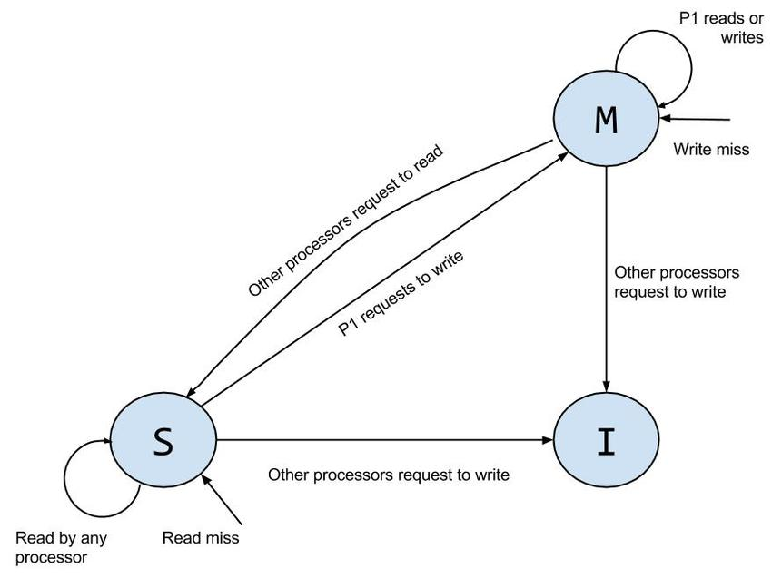
The block with tag 0x123 is present in Core 0’s cache and Core 1’s cache
The cache line with MSI bits are as shown below. If Core 0 requests to write to the block, what are the resulting states of this cache line in each core?
Core 0
M | S | I | Tag | Data
0 | 1 | 0 | 0x123 | 0x1322AA80
Core 1
M | S | I | Tag | Data
0 | 1 | 0 | 0x123 | 0x1322AA80
Core 0
Core 1

Slide 20
The block with tag 0x123 is present in Core 0’s cache and Core 1’s cache
The cache line with MSI bits are as shown below. If Core 0 requests to write to the block, what are the resulting states of this cache line in each core?
Core 0
M | S | I | Tag | Data
1 | 0 | 0 | 0x123 | 0x3321A097
Core 1
M | S | I | Tag | Data
0 | 0 | 1 | 0x123 | 0x1322AA80
Core 0
Core 1
Core 0 moves to modified state, so the M bit is changed to 1 and the S bit is changed to zero
Snooping protocol notices the write and moves the Core 1 line into the I state

Slide 21
The block with tag 0x123 is present in Core 0’s cache and Core 1’s cache
The cache line with MSI bits are as shown below. If Core 1 requests to read this block, what are the resulting cache line states?
Core 0
M | S | I | Tag | Data
1 | 0 | 0 | 0x123 | 0x3321A097
Core 1
M | S | I | Tag | Data
0 | 0 | 1 | 0x123 | 0x1322AA80
Core 0
Core 1

Slide 22
The block with tag 0x123 is present in Core 0’s cache and Core 1’s cache
The cache line with MSI bits are as shown below. If Core 1 requests to write this block, what are the resulting cache line states?
Core 0
M | S | I | Tag | Data
0 | 1 | 0 | 0x123 | 0x3321A097
Core 1
M | S | I | Tag | Data
0 | 1 | 0 | 0x123 | 0x3321A097
Core 1 has a read miss because it is in the I state.
Snooping protocol causes Core 0 to notice and write the new data to the L2 cache and move into the S state
Core 1 gets the updated data from the L2 cache and moves into the S state
Core 0
Core 1

Slide 23
A shared memory processing system has 4 processors. A program consists of a section that must be executed sequentially and requires 10 ns. The remainder of the program can be parallelized and requires 90 ns. What is the speedup obtained when running this program on 4 processors?

Slide 24
A shared memory processing system has 4 processors. A program consists of a section that must be executed sequentially and requires 10 ns. The remainder of the program can be parallelized and requires 90 ns. What is the speedup obtained when running this program on 4 processors?
Non parallel processing time: 100 ns
Parallel processing time: 10 + 90/4 = 32.5 ns
Speedup = 100/32.5 = 3.08

Slide 25
If I have 10 processors, what fraction of a program must be parallelizable in order to get a speedup of 5?

Slide 26
If I have 10 processors, what fraction of a program must be parallelizable in order to get a speedup of 5?
5 = 1/(F/10 + (1-F))
5*(F/10 + (1-F) = 1
F/2 + 5(1-F) = 1
F + 10 – 10F = 2

Slide 27
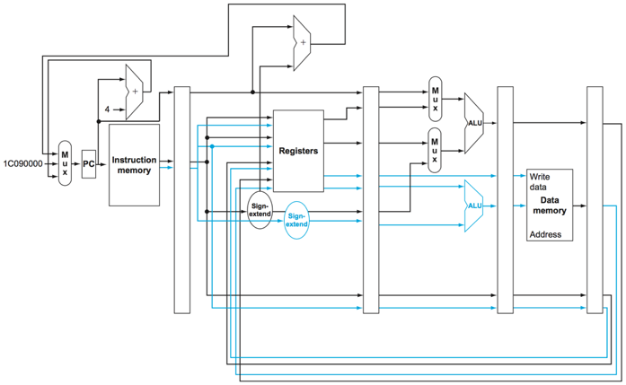
Static Multiple Issue Pipeline
Notes:
The static multiple issue pipeline allows execution of a load or store and an r-type or branch at the same time
Instructions can also be rearranged to allow for most efficient execution.

Slide 28
These instructions are to be executed on the static multiple issue pipeline shown in the previous slide. An issue packet can consist of one load or store and/or one r-type or branch.
What will be contained in the first packet issued to the pipeline.
sub x5, x3, x4
add x1, x3, x4
stur x1, [x0, #8]
ldur x2, [x0, #4]
add x5, x2, x2
stur x5, [x0, #12]
sub x7, x5, x2
cbz x7, #3

Slide 29
These instructions are to be executed on the static multiple issue pipeline shown in the previous slide. An issue packet can consist of one load or store and/or one r-type or branch.
What will be contained in the first packet issued to the pipeline.
sub x5, x3, x4
add x1, x3, x4
stur x1, [x0, #8]
ldur x2, [x0, #4]
add x5, x2, x2
stur x5, [x0, #12]
sub x7, x5, x2
cbz x7, #3
need one r-type and one load or store
stur is the first r-type, but it can’t be in the first packet because is dependent on the add

Slide 30
These instructions are to be executed on the static multiple issue pipeline shown in the previous slide. An issue packet can consist of one load or store and/or one r-type or branch.
What will be contained in the first packet issued to the pipeline?
sub x5, x3, x4
add x1, x3, x4
stur x1, [x0, #8]
ldur x2, [x0, #4]
add x5, x2, x2
stur x5, [x0, #12]
sub x7, x5, x2
cbz x7, #3
need one r-type and one load or store
stur is the first r-type, but it can’t be in the first packet because is dependent on the add
First packet should be:
add x1, x3, x4
ldur x2, [x0, #4]
Are there any data hazards?

Slide 31
These instructions are to be executed on the static multiple issue pipeline shown in the previous slide. An issue packet can consist of one load or store and/or one r-type or branch.
What will be contained in the first packet issued to the pipeline?
sub x5, x3, x4
add x1, x3, x4
stur x1, [x0, #8]
ldur x2, [x0, #4]
add x5, x2, x2
stur x5, [x0, #12]
sub x7, x5, x2
cbz x7, #3
First packet should be:
add x1, x3, x4
ldur x2, [x0, #4]
Are there any data hazards?
There is a load-use hazard and a data hazard with the branch instruction
We can help with the load-use hazard with add x5, x2, x2 by putting a different r-type in the next packet – thus putting another instruction in what would have been a stall spot
What is in the second packet:

Slide 32
These instructions are to be executed on the static multiple issue pipeline shown in the previous slide. An issue packet can consist of one load or store and/or one r-type or branch.
What will be contained in the first packet issued to the pipeline?
sub x5, x3, x4
add x1, x3, x4
stur x1, [x0, #8]
ldur x2, [x0, #4]
add x5, x2, x2
stur x5, [x0, #12]
sub x7, x5, x2
cbz x7, #3
First packet should be:
add x1, x3, x4
ldur x2, [x0, #4]
Are there any data hazards?
There is a load-use hazard and a data hazard with the branch instruction
We can help with the load-use hazard with add x5, x2, x2 by putting a different r-type in the next packet – thus putting another instruction in what would have been a stall spot
What is in the second packet:
sub x5, x3, x4
stur x1, [x0, #8]

Slide 33
These instructions are to be executed on the static multiple issue pipeline shown in the previous slide. An issue packet can consist of one load or store and/or one r-type or branch.
What will be contained in the first packet issued to the pipeline?
sub x5, x3, x4
add x1, x3, x4
stur x1, [x0, #8]
ldur x2, [x0, #4]
add x5, x2, x2
stur x5, [x0, #12]
sub x7, x5, x2
cbz x7, #3
First packet should be:
add x1, x3, x4
ldur x2, [x0, #4]
What is in the second packet:
sub x5, x3, x4
stur x1, [x0, #8]
What is in the third packet?
Can’t put these together because the store depends on the add

Slide 34
These instructions are to be executed on the static multiple issue pipeline shown in the previous slide. An issue packet can consist of one load or store and/or one r-type or branch.
What will be contained in the first packet issued to the pipeline?
sub x5, x3, x4
add x1, x3, x4
stur x1, [x0, #8]
ldur x2, [x0, #4]
add x5, x2, x2
stur x5, [x0, #12]
sub x7, x5, x2
cbz x7, #3
First packet should be:
add x1, x3, x4
ldur x2, [x0, #4]
What is in the second packet:
sub x5, x3, x4
stur x1, [x0, #8]
What is in the third packet?
Can’t put these together because the store depends on the add
There isn’t another load/store, so third packet contains only:
add x5, x2, x2
What is in the fourth packet?

Slide 35
These instructions are to be executed on the static multiple issue pipeline shown in the previous slide. An issue packet can consist of one load or store and/or one r-type or branch.
What will be contained in the first packet issued to the pipeline?
sub x5, x3, x4
add x1, x3, x4
stur x1, [x0, #8]
ldur x2, [x0, #4]
add x5, x2, x2
stur x5, [x0, #12]
sub x7, x5, x2
cbz x7, #3
First packet should be:
add x1, x3, x4
ldur x2, [x0, #4]
What is in the second packet:
sub x5, x3, x4
stur x1, [x0, #8]
What is in the third packet:
add x5, x2, x2
What is in the fourth packet?
stur x5, [x0, #12]
sub x7, x5, x2
What is in the fifth packet?

Slide 36
These instructions are to be executed on the static multiple issue pipeline shown in the previous slide. An issue packet can consist of one load or store and/or one r-type or branch.
First packet should be:
add x1, x3, x4
ldur x2, [x0, #4]
What is in the second packet:
sub x5, x3, x4
stur x1, [x0, #8]
What is in the third packet:
add x5, x2, x2
What is in the fourth packet?
stur x5, [x0, #12]
sub x7, x5, x2
What is in the fifth packet?
cbz x7, #3
(with a stall because of the data hazard)
sub x5, x3, x4
add x1, x3, x4
stur x1, [x0, #8]
ldur x2, [x0, #4]
add x5, x2, x2
stur x5, [x0, #12]
sub x7, x5, x2
cbz x7, #3

Slide 37
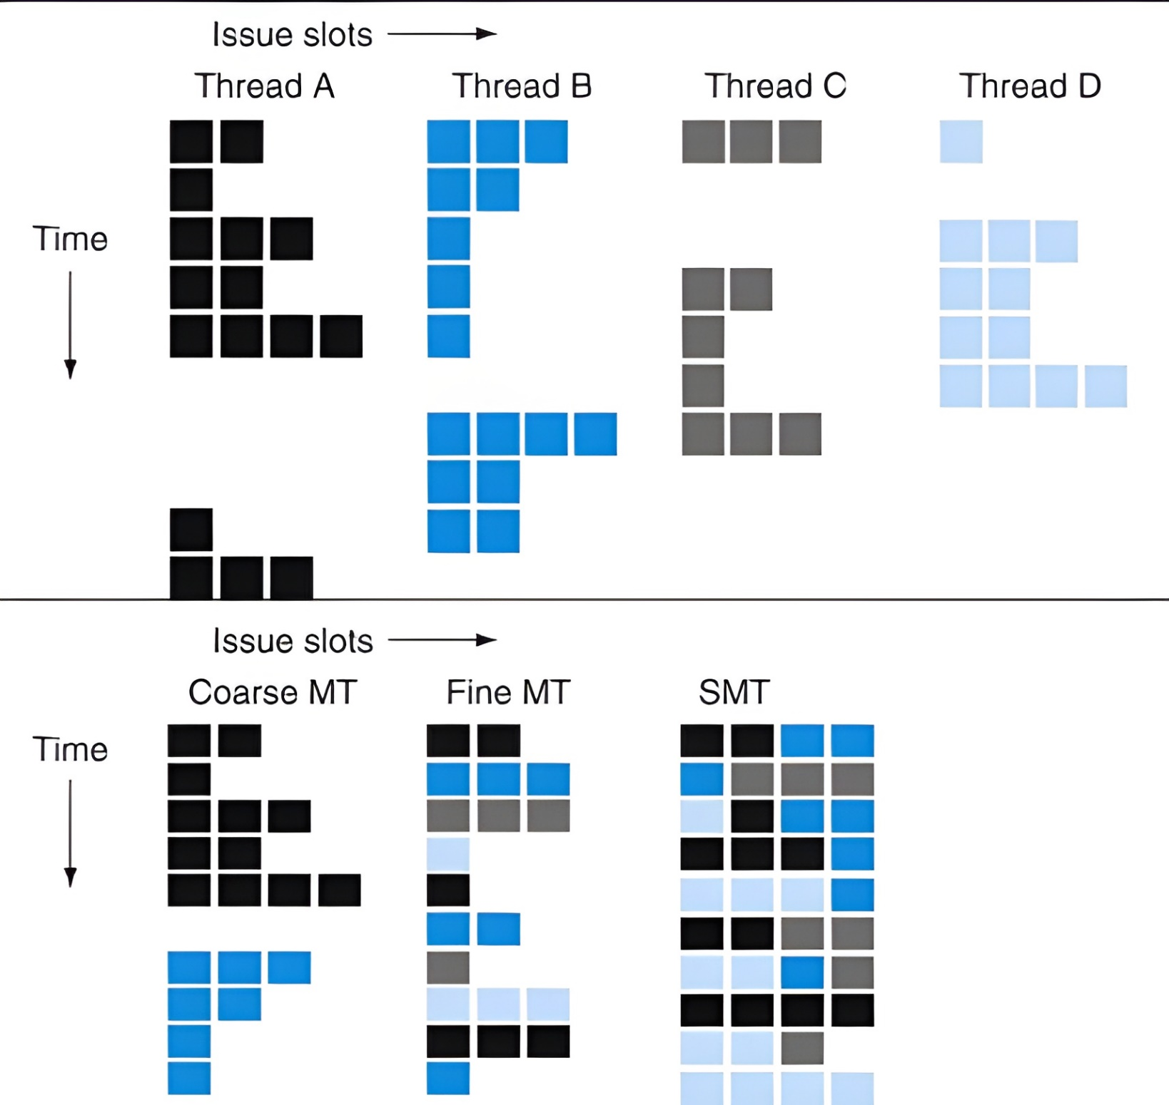
Multi-Threading
Issue Slots
Thread A
Thread B
Thread C
Thread D
Time
Issue Slots
Coarse MT
Fine MT
SMT
Time
(© Morgan Kaufmann)
Notes:
OFF SCREEN
Here is an example from our book. [CLICK]
At the top we see a depiction of four threads.
The horizontal dimension is instructions. The vertical dimension is clock cycle. [CLICK]
on the first clock cycle thread A fetches two instructions. [CLICK]
On the second clock cycle thread A fetches one instruction. [CLICK]
We see at the 6th clock cycle thread A has a long stall [CLICK]
in a coarse grained multithreading system, shown in the bottom left, thread A would run until the long stall.
Then switch to thread B and run until the long stall
Then not shown is switching to C, and so on
[CLICK – Next Slide]

Slide 38
Thread A Thread B Thread C Thread D

Slide 39
Cycle
1
2
3
4
5
6
7
8
9
10
11
12
13
14
15
16
17
18
19
20
21
22
23
24
25
26
27
28
29
30
31
32
33
34
35
36
Coarse grained multi-threading

Slide 40
Cycle
1
2
3
4
5
6
7
8
9
10
11
12
13
14
15
16
17
18
19
20
21
22
23
24
25
26
27
28
29
30
31
32
33
34
35
36
Fine grained multi-threading

Slide 41
Cycle
1
2
3
4
5
6
7
8
9
10
11
12
13
14
15
16
17
18
19
20
21
22
23
24
25
26
Simultaneous multi-threading

Slide 42
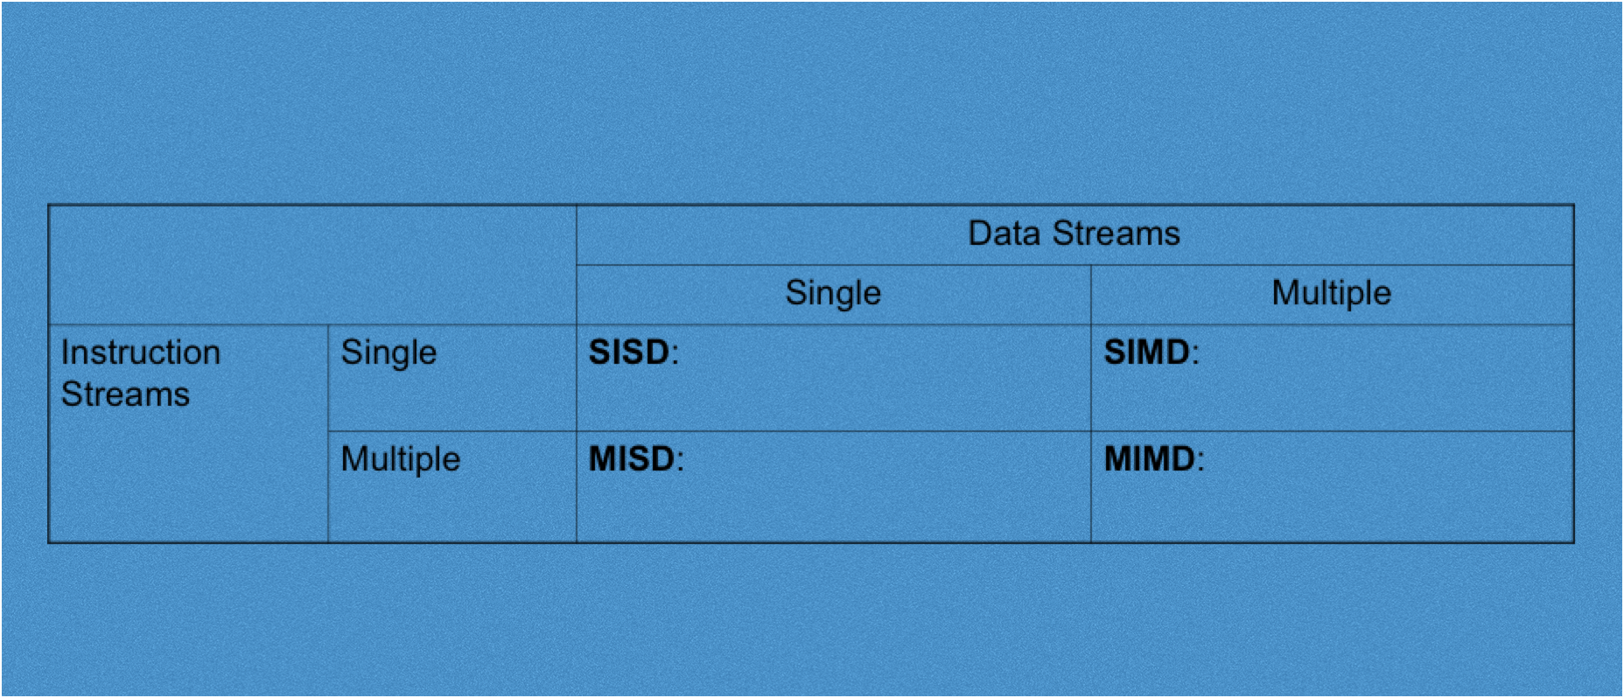
Flynn’s Taxonomy
Vector processing – same operation on a vector of values.
Handled with vector instructions and registers.

Slide 43
Flynn’s Taxonomy
No “processor” that does this. But fault tolerance and having multiple computers operating on the same data could fall into this category

Slide 44
Flynn’s Taxonomy
Single program, multiple data
Shared memory processing

Slide 45
Flynn’s Taxonomy
Single program, multiple data
multiple processors networked together to accomplish a task

Slide 46
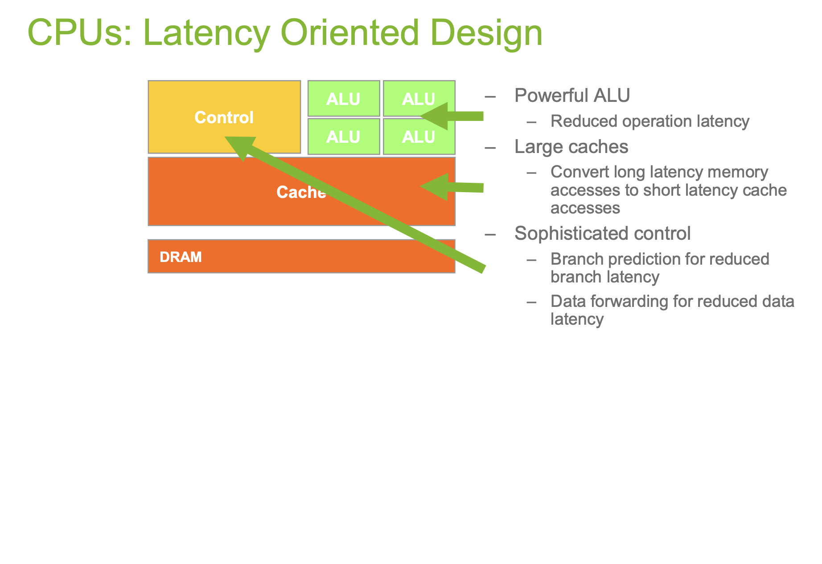

Slide 47
